Slide 1
SQL & NoSQL Vulnerabilities
By:
Ali Mehrani
Ali Eftekhari
Taha Ebrahimzadeh

Slide 2
Introduction to SQL Databases
Structured Databases
Using SQL for data definition and manipulation
Relational data model
Schema-based design
ACID compliance

Slide 3


Introduction to SQL Databases
Available on cloud services
Plenty of options to choose
MySQL, PostgreSQL, Oracle Database, SQLite and more

Slide 4
Introduction to SQL Databases
Ensuring data integrity with ACID Properties:
Atomicity, Consistency, Isolation, and Durability
Use cases including:
Transactional applications
Web & Enterprise applications
Data analytics
Data warehousing

Slide 5
Introduction to NoSQL Databases
Non-relational data model
Flexible schema design
less structured compared to relational SQL databases
suitable for storing distributed data
High scalability

Slide 6
Introduction to NoSQL Databases
Highly used in large-scale systems
Use cases including:
Big data applications
Real-time web applications
Content and media streaming systems

Slide 7
Introduction to NoSQL Databases
NoSQL databases have different structures, with each type handling data in its unique way. Some examples include:
Document Stores Storing data in documents MongoDB, Apache CouchDB Documents can have different structures | Key-Value Stores Storing data in key-value pairs Redis, Amazon DynamoDB High performance

Slide 8
Introduction to NoSQL Databases
Some other examples for NoSQL databases structure include
Graph Stores Represents data in nodes and edges Interconnected data Flexible schema Neo4j, Amazon Neptune-AWS | Wide-column Stores Storing data in columns instead of rows Columns grouped into families Flexible schema Cassandra, ScyllaDB, HBase

Slide 9
Database Vulnerabilities
Database vulnerabilities can arise for various reasons. Here are some of the most common vulnerabilities in SQL/NoSQL database systems:
SQL/NoSQL Injection | Insecure Direct Object Reference (IDOR)
Data Inconsistency (NoSQL) | Database system Misconfiguration
Privilege Escalation | Weak Authentication and Authorization
Inappropriate Encryption | Buffer Overflow

Slide 10
SQL/NoSQL Injection
SQL Injection
Inserting malicious SQL code into queries
Prevented by using Object-relational mapping (ORM) for RDBMS
NoSQL injection is another variant for NoSQL databases
NoSQL variant similarly targets NoSQL queries (e.g. cassandra CQL)

Slide 11
SQL Injection Example
Consider a login page in a web app:
Entered field values are sent directly to the query with no preprocessing.
SELECT * FROM users WHERE username = 'username_in' AND password = 'pass_in';
Attacker enters:
Username: 'admin' OR 1=1 --' and password: 'something'
The query is now:
SELECT * FROM users WHERE username = 'admin' OR 1=1 --' AND password = 'something';
The --' comments the rest of the query.

Slide 12
SQL Injection Prevention
Using prepared statements: ensures that queries are compiled first and the parameters are passed later
Validating inputs: manually check for malicious inputs.
Web App Firewall (WAF): protects web apps from numerous attacks including SQL injection.
Object-relational mapping (ORM): checks for malicious inputs, protects the DB.

Slide 13
NoSQL Injection Example
Consider this script for finding user data in MongoDB
function findUser(request) {
username=request.username;
password=request.password;
user = db.collection('users').findOne({ username: username, password: password });
user ? return (user, ‘login success’) : (‘login failure’);
}

Slide 14
NoSQL Injection Example
The attacker will enter the following JSON as the request input for the function
The following will be executed and will bypass the password checking procedure.
db.collection('users').findOne({ username: "admin", password: { "$ne": null } })
{
"username": "admin",
"password": { "$ne": null }
}

Slide 15
NoSQL Injection Prevention
Validating Inputs: checking input validity either manually or by using libraries or frameworks
Web application firewall: protects the web app from malicious traffic
Prepared Statements: NoSQL Databases might allow using prepared statements for execution
Object-Document mapping: Document-store databases might allow using ODMs which will handle input verification automatically

Slide 16
Insecure Direct Object Reference (IDOR)
An access control vulnerability arising when users directly access system objects and resources.
Not directly about the DB but about the access control
Attacker mostly attacks by manipulating the URL
Among owasp vulnerabilities
Predictable URL behaviour which references DB objects directly

Slide 17
IDOR Examples
Suppose the following URL:
https://university.com/stdinfo/810100000.txt
A student data is stored in a text file accessed by a static URL
Attacker can access any student data by changing the StdNo. in the URL.
Can be prevented by implementing proper access controls.

Slide 18
Data Inconsistency (NoSQL)
Causes:
Eventual Consistency
Distribution
Network issues
Node failures
Lack of ACID Transactions

Slide 19
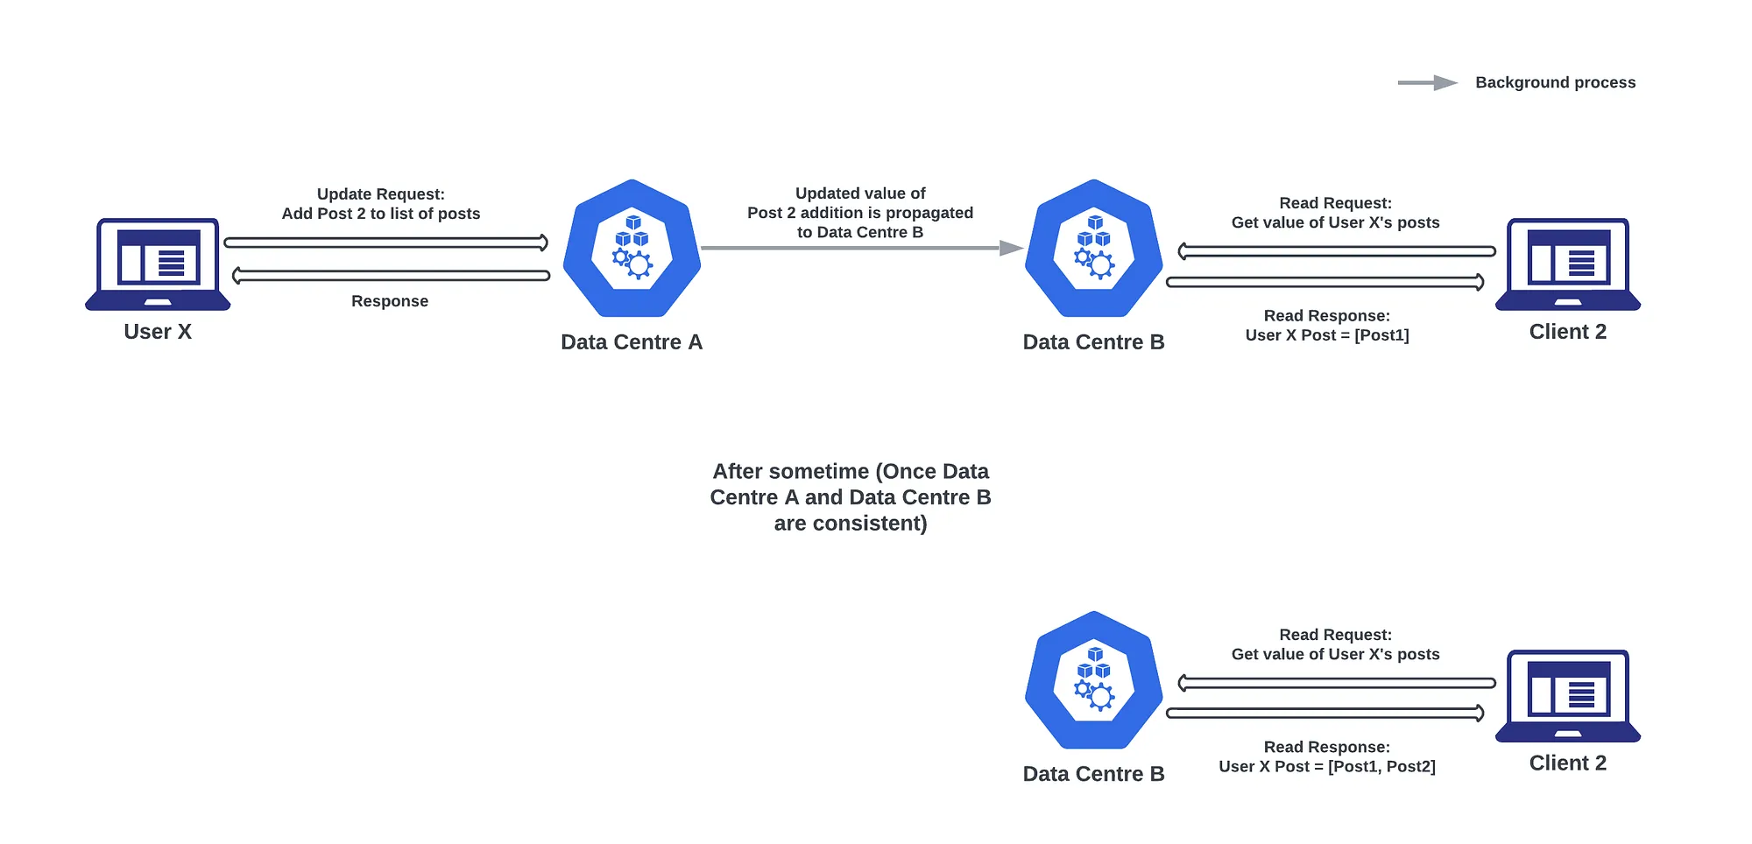
Data Inconsistency (NoSQL)

Slide 20
Database System Misconfiguration
Common vulnerabilities:
Open Network Access
Exposing the database to the public internet without proper firewalls
Unrestricted IP access
Missing Security Patches and Updates
Misconfigured Backup Settings
Improper Database Isolation

Slide 21
Database System Misconfiguration
Solutions:
Secure Network Access
Restrict database access to trusted IP addresses
Use firewalls and VPNs to protect database access
Keep Software Up-to-Date
Implement Robust Backup Solutions
Configure regular, automated backups of the database
Regular Audits and Penetration Testing

Slide 22
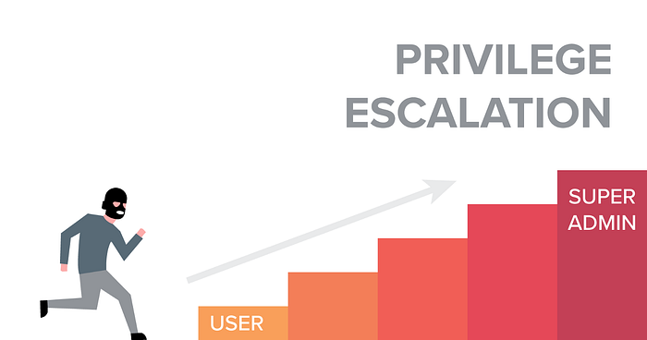
Privilege Escalation
Vertical Privilege Escalation
user gains higher privileges
Horizontal Privilege Escalation
user accesses another user's resources with similar privileges

Slide 23
Privilege Escalation
Causes:
Improper Validation
Weak Authentication
Can allow attackers to bypass authentication
Software Bugs
Attackers can use an exploit to gain access
Misconfigured Database Permissions
Unauthorized users can gain access

Slide 24
Privilege Escalation
Solutions:
Input Validation
Multi-factor Authentication
Principle of Least Privilege
Patch Management

Slide 25
Weak Authentication and Authorization
Authentication
verifying the identity of a user or a system.
Authorization
determines the level of access granted to authenticated users.

Slide 26
Weak Authentication and Authorization
Common weaknesses for both SQL/NoSQL:
Default Credentials
Lack of Multi-Factor Authentication (MFA)
Weak Password Policies
Improper Access Controls

Slide 27
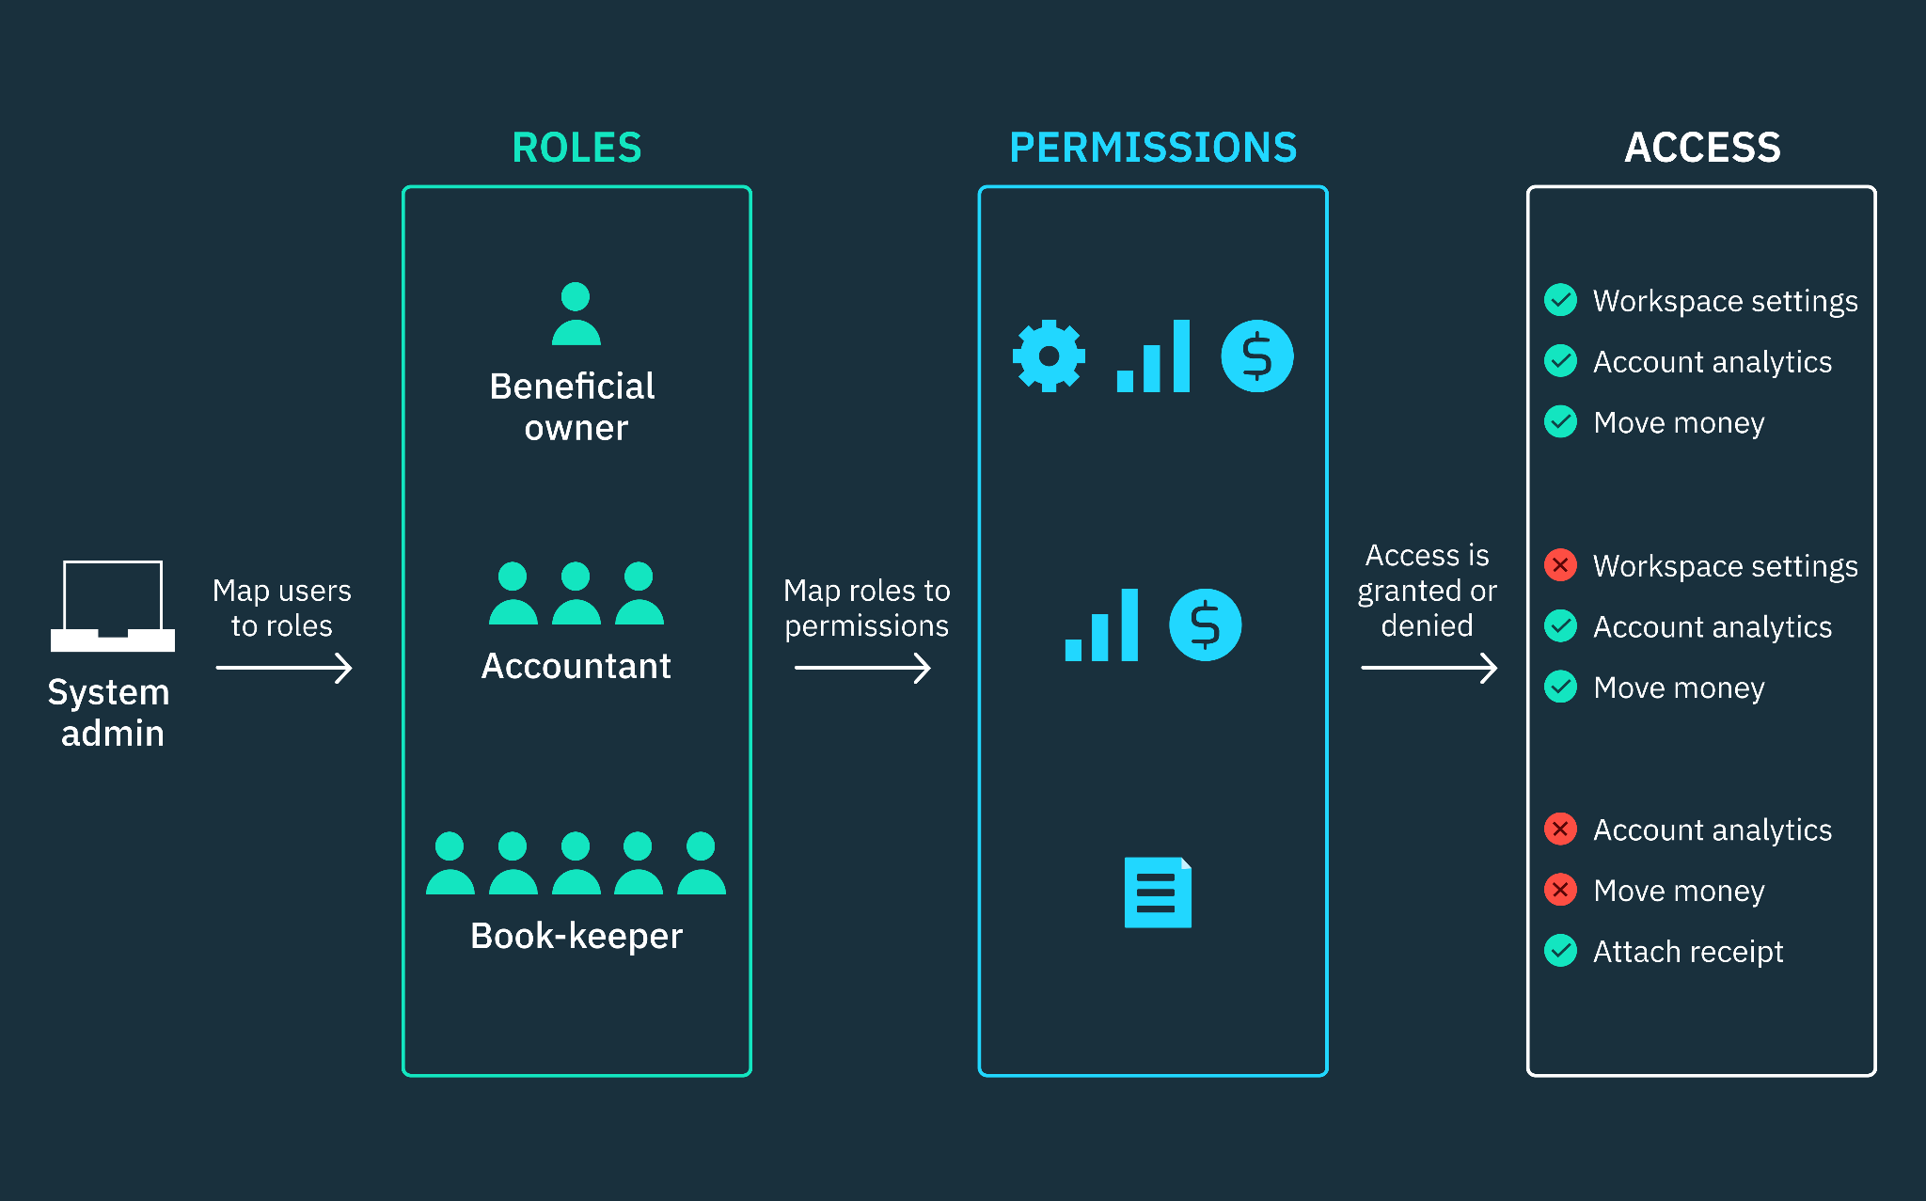
Weak Authentication and Authorization
Plaintext Storage of Credentials
Lack of Role-Based Access Control
Poor Session Management

Slide 28
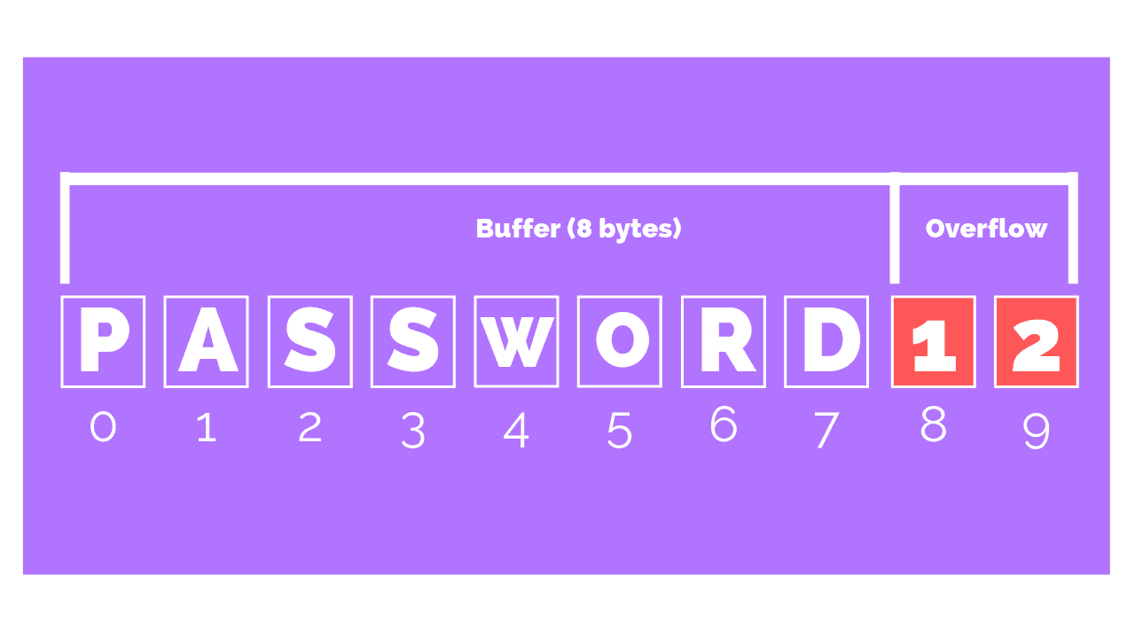
Buffer Overflow
Stack-based Buffer Overflow: This is the most common type. It occurs when the stack, a memory area that stores local variables and controls the order of execution, is overflowed.
Heap-based Buffer Overflow: This occurs in the heap, a memory area used for dynamic allocation.
Preventions:
Maintenance
Input validation
Memory management
Filtering the data

Slide 29
Buffer Overflow
Example:
char buffer[256];
strcpy(buffer, userInput); // Vulnerable to overflow if userInput exceeds 256 bytes
Solution:
strncpy(buffer, userInput, sizeof(buffer) - 1);
buffer[sizeof(buffer) - 1] = '\0'; // Ensure null-termination

Slide 30
Inappropriate Encryption
Weak Encryption Algorithms
Using algorithms like DES which can be easily broken
Short Encryption Keys
Using short keys such as 56-bit keys instead of stronger keys like 256-bit keys.
Poor Implementation
Incorrect use of cryptographic libraries, or failing to use secure modes of operation (like using ECB instead of CBC for block ciphers).
Encryption Performance Issues
Overhead of strong encryption impacting database performance

Slide 31
References
https://ibm.com/topics/database-security
https://owasp.org
https://www.proofpoint.com/us/threat-reference/privilege-escalation
https://janmuhammadzaidi.medium.com/vertical-privilege-escalation-the-user-can-takeover-an-admin-account-via-response-manipulation-9237c8b2fefa

Slide 32
Thank you
for your attention!

